Slide 1
Shapes
Unraveling the Web of Information: A Comprehensive Study on Bangla Misinformation, Disinformation, Satire and Fake News
Hrithik Majumdar Shibu
Reg No: 2018331052
Nasrullah Sami
Reg No: 2018331036
Supervisor Mahruba Sharmin Chowdhury Assistant Professor Department of CSE, SUST
Presenter Name

Slide 2
Outline
Introduction
Objectives
Related Works
Gaps in Literature
Our Approach
Why Classify?
Data Collection
Methodology
Evaluation
Future Works

Slide 3
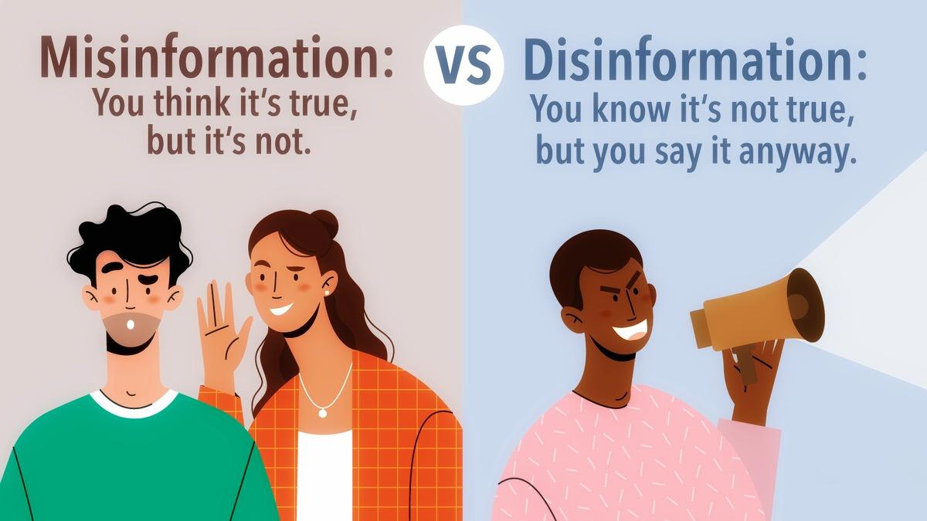
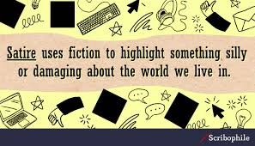

Introduction
Misinformation 🙁
Disinformation 😥
Satire 😂
REAL!!!
Figure: Introducing Misinformation, Disinformation and Satire

Slide 4
Comprehension With Examples
Misinformation
“Eating chocolates can make you immune to common cold.”
Disinformation
“A celebrity endorsed a controversial product, accompanied by doctored photos to make it seem real.”
Satire
“A town plans to tax residents based on the number of selfies they take.”

Slide 5
Objectives
Create a benchmark multi-labelled dataset by merging existing data with new data.
Implement proposed model architecture based on Siamese Neural Network.
Achieve pragmatic accuracy on the imbalanced multi-labelled dataset.

Slide 6
Related Works
AUTHOR | MODEL | WORK | CLASS
Hossain et al.¹ | SVM, LR, RF, BERT etc. | Benchmark dataset for Bangla fake news detection | Binary – Fake or Real
Sharma et al.² | CNN + Feature Extraction Model | Satire detection | Binary – Satire or Non-Satire
George et al.³ | CNN-LSTM | Fake news detection | Binary – Fake or Real
Zhou et al.⁴ | Siamese Neural Network | Fake news stance detection | Binary – Related or Unrelated

Slide 7
Gaps in Literature
Fake news can be classified into further sub-categories.
Existing Bangla fake news datasets are imbalanced. Consequently, model performances are not always accurate.

Slide 8
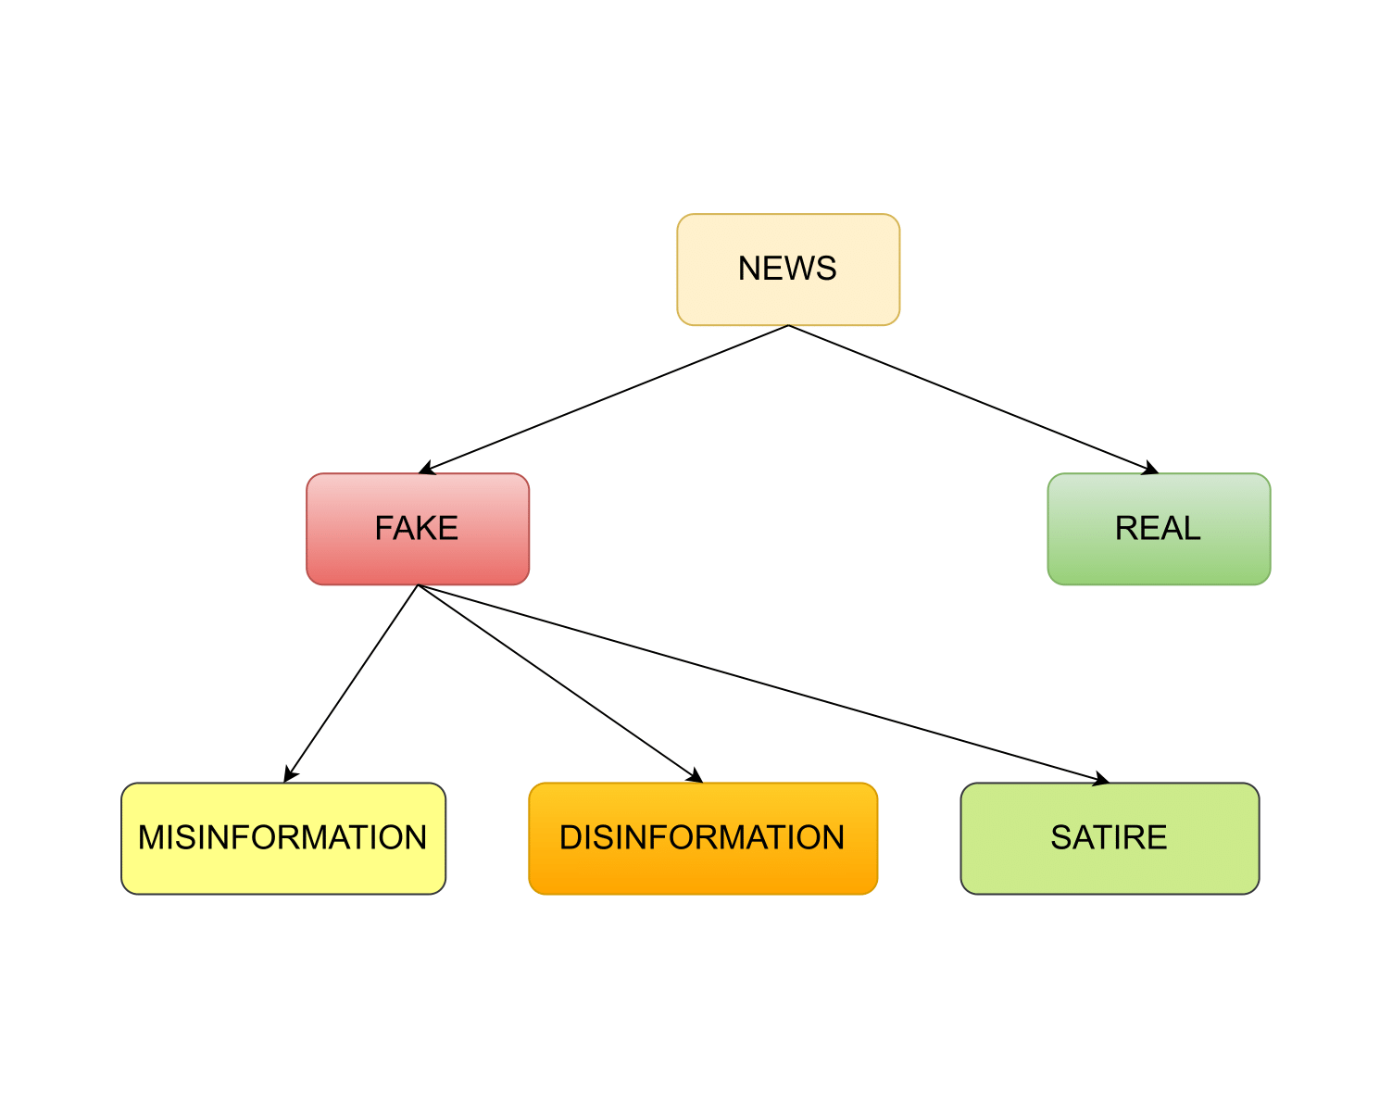
Our Approach
Classify fake news into 3 classes:
Misinformation
Disinformation
Satire
Use Siamese Neural Network that works well with imbalanced datasets.
Figure: Fake news classification

Slide 9
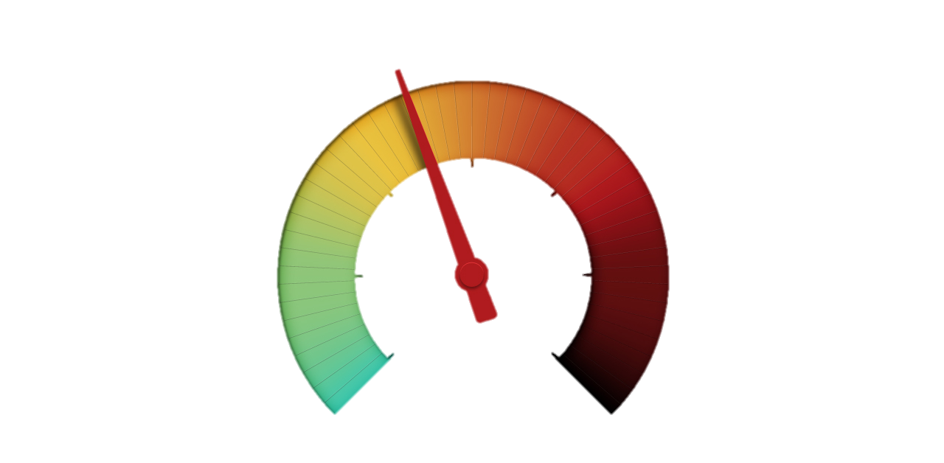
WHY CLASSIFY?
Not all fake news is created equal.
Different mitigation approaches.
Adjust search engine algorithms.
Further research works.
Misinformation
Satire
Disinformation

Slide 10
Data Collection
Category | Sources | Number of data
Real | Hossain et al. – BanFakeNews¹ Sadik Al Jarif – Kaggle⁵ Hussain et al.⁶ | 67428
Fake | Sadik Al Jarif – Kaggle Hossain et al. – BanFakeNews¹ Hussain et al.⁶ Data crawling | 5540
Satire | Sharma et al.² Hossain et al. – BanFakeNews¹ | 2773

Slide 11
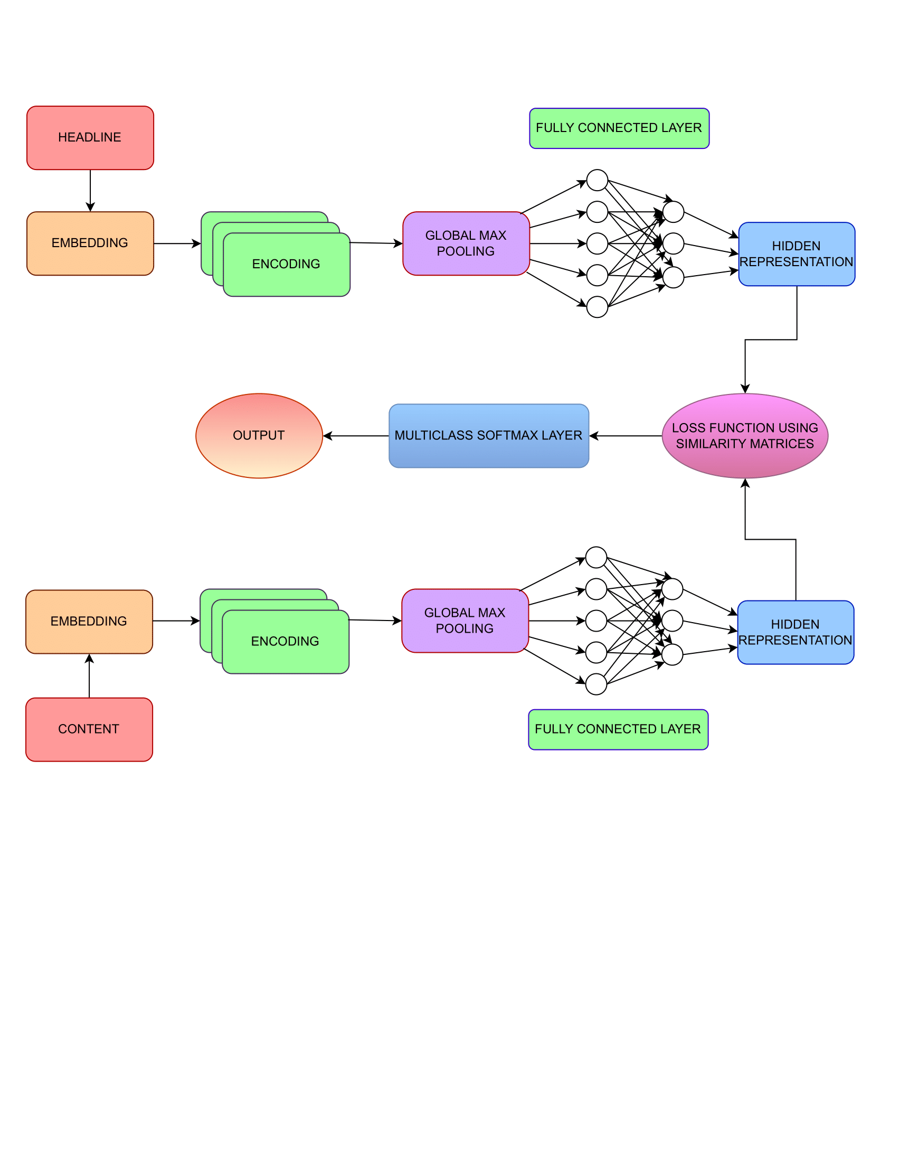
Methodology
Figure : Our proposed Siamese Neural Network

Slide 12
Methodology (Contd.)
Word Embedding
Generates vector representation of each word.
Sentence Encoding.
Captures contexts of the sequence from the embeddings.
Global Max Pooling
Merge attention heads taking the max value of each head from encodings.
Fully Connected Layers
Dense Neural Network with multiple hidden layers.

Slide 13
Methodology (Contd.)
Hidden Representations
Result is represented in lower dimension and more abstract form to capture important features.
Loss function using Similarity Matrices
Optimizes the process by penalizing incorrect predictions and encourages creating more accurate embeddings.
Multiclass Softmax Layer
Based on a multi class output layers containing 4 type of output neurons.
Output
Provides the final output from the multiclass softmax layer.

Slide 14
Evaluation (Baseline Models)
MODEL | Experiment Name | REAL |  | FAKE
 |  | Precision | F1-score | Precision | F1-score
SVM | Unigram | 0.95 | 0.97 | 0.82 | 0.69
SVM | Bigram | 0.95 | 0.96 | 0.78 | 0.64
SVM | Trigram | 0.94 | 0.96 | 0.75 | 0.60
SVM | C3-gram | 0.95 | 0.97 | 0.83 | 0.69
LR | Unigram | 0.94 | 0.97 | 1.00 | 0.65

Slide 15
Future Works
Allocate 10K+ fake news and create a new multi-labelled dataset.
Preprocess our dataset (Removing numbers, punctuations, whitespaces, tokenize, lemmatize, stemming etc.)
Implement proposed model architecture.
Compare the outcome with baseline models.

Slide 16
References
M. Z. Hossain, M. A. Rahman, M. S. Islam, and S. Kar, “Banfakenews: A dataset for detecting fake news in bangla.”
A. S. Sharma, M. A. Mridul, and M. S. Islam, “Automatic detection of satire in bangla documents: A cnn approach based on hybrid feature extraction model.”
M. Z. H. George, N. Hossain, M. R. Bhuiyan, A. K. M. Masum, and S. Abujar, “Bangla fake news detection based on multichannel combined cnn-lstm.”
Z. Zhou, Y. Yang, and Z. Li, “Apsn: Adversarial pseudo-siamese network for fake news stance detection.”
Link - https://www.kaggle.com/datasets/sadikaljarif/bangla-fake-news-detection-dataset
M. G. Hussain, M. Rashidul Hasan, M. Rahman, J. Protim, and S. Al Hasan, “Detection of bangla fake news using mnb and svm classifier.”

Slide 17
Thank you!!!
Any Queries?

